Slide 1

RMI
Remote Procedure Calls
RMI
RMI Registry

Slide 2
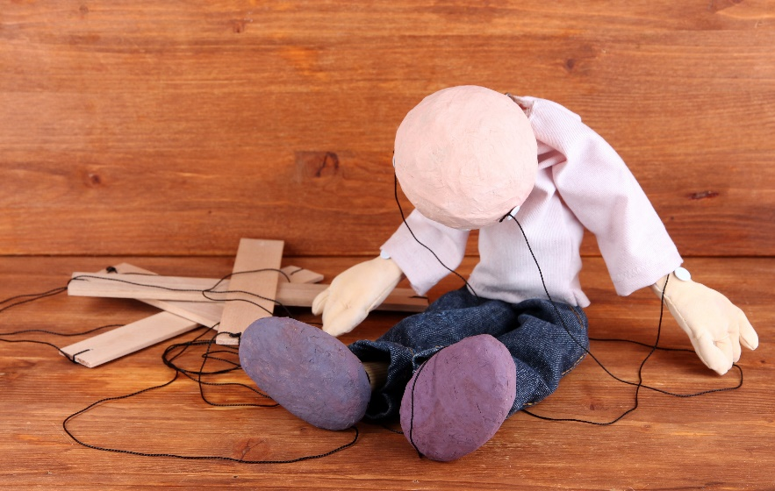
See Also
https://docs.oracle.com/javase/tutorial/rmi/
https://en.wikipedia.org/wiki/Java_remote_method_invocation

Slide 3
Communication Protocols
OutputStream
InputStream
Hello
World
1
Hello World
InputStream
OutputStream
Send me command value “1”
Send me two strings
I’ll return you one string
excited
2
EXCITED
Send me command value “2”
Send me one
I’ll return you one string
Streams of bytes … two ways (into your program and out of your program)
Disks, consoles, sockets, keyboards, printers
Know how to talk streams and you can talk to anything
Initialization (constructor) is different. Use is the same.

Slide 4
Communication Protocols
public class StringUtil {
public String append(String a, String b) {
return a+b;
}
public String allCaps(String s) {
return s.toUpperCase();
}
}
public void client() {
StringUtil util = new StringUtil();
String a = util.append("Hello", "World");
a = util.allCaps("excited");
}
Streams of bytes … two ways (into your program and out of your program)
Disks, consoles, sockets, keyboards, printers
Know how to talk streams and you can talk to anything
Initialization (constructor) is different. Use is the same.

Slide 5
Remote Procedure Call
public String append(String a, String b)
public String allCaps(String s)
Stub
Skeleton
public String append(String a, String b)
public String allCaps(String s)
Streams of bytes … two ways (into your program and out of your program)
Disks, consoles, sockets, keyboards, printers
Know how to talk streams and you can talk to anything
Initialization (constructor) is different. Use is the same.

Slide 6
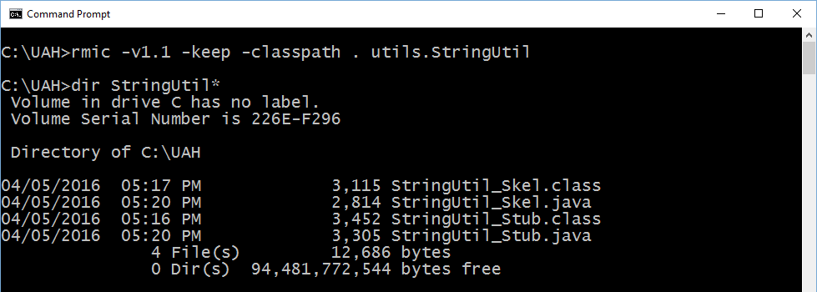
Remote Method Invocation
Early version of Java required the “rmic” tool
Generated the stubs and skeletons for you
Option to keep generated source code (not needed)
Streams of bytes … two ways (into your program and out of your program)
Disks, consoles, sockets, keyboards, printers
Know how to talk streams and you can talk to anything
Initialization (constructor) is different. Use is the same.

Slide 7

Generated Code
public final class StringUtil_Skel implements java.rmi.server.Skeleton {
public void dispatch(java.rmi.Remote obj, java.rmi.server.RemoteCall call,
int opnum, long hash) throws java.lang.Exception {
utils.StringUtil server = (utils.StringUtil) obj;
switch (opnum) {
case 0: // allCaps(String)
{
java.lang.String $param_String_1;
java.io.ObjectInput in = call.getInputStream();
$param_String_1 = (java.lang.String) in.readObject();
java.lang.String $result = server.allCaps($param_String_1);
java.io.ObjectOutput out = call.getResultStream(true);
out.writeObject($result);
break;
}
case 1: // append(String, String)
Streams of bytes … two ways (into your program and out of your program)
Disks, consoles, sockets, keyboards, printers
Know how to talk streams and you can talk to anything
Initialization (constructor) is different. Use is the same.

Slide 8


Modern Java RMI
Client
Stub
Skeleton
Server
As of Java 2 SDK 1.2 (1998): Skeletons are no longer needed
As of Java 5 SDK 1.5 (2004): Dynamic Proxies instead of stubs
Streams of bytes … two ways (into your program and out of your program)
Disks, consoles, sockets, keyboards, printers
Know how to talk streams and you can talk to anything
Initialization (constructor) is different. Use is the same.

Slide 9
Remote Interface
import java.rmi.Remote;
import java.rmi.RemoteException;
public interface StringUtil {
public String append(String a, String b) ;
public String allCaps(String s) ;
}
extends Remote {
throws RemoteException;
throws RemoteException;
Must extend the “Remote” interface to give permission (compile time check)
Each method must throw a checked RemoteException (run time check)
Streams of bytes … two ways (into your program and out of your program)
Disks, consoles, sockets, keyboards, printers
Know how to talk streams and you can talk to anything
Initialization (constructor) is different. Use is the same.

Slide 10
Server Object Implementation
public class StringUtilImpl implements StringUtil {
@Override
public String append(String a, String b) {
return a+b;
}
@Override
public String allCaps(String s) {
return s.toUpperCase();
}
}
The Caller must handle “RemoteException”, but your implementation doesn’t have to throw it.
Streams of bytes … two ways (into your program and out of your program)
Disks, consoles, sockets, keyboards, printers
Know how to talk streams and you can talk to anything
Initialization (constructor) is different. Use is the same.

Slide 11
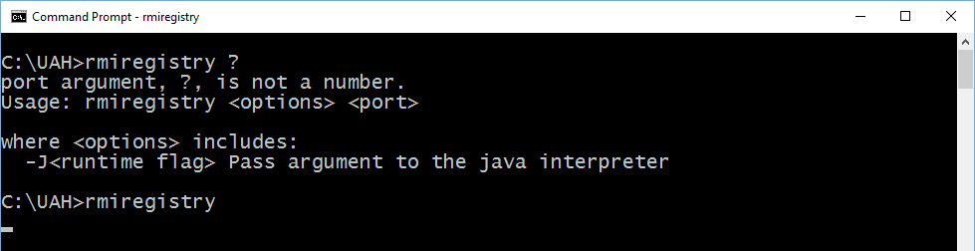
RMI Registry
Separate server (usually port 1099)
Provides a string name to published objects
Must be running for RMI to work (maybe in a separate window)
Must have the classpath to your published objects (maybe launched from your application’s bin directory)
Streams of bytes … two ways (into your program and out of your program)
Disks, consoles, sockets, keyboards, printers
Know how to talk streams and you can talk to anything
Initialization (constructor) is different. Use is the same.

Slide 12
Server
import java.rmi.registry.LocateRegistry;
import java.rmi.registry.Registry;
import java.rmi.server.UnicastRemoteObject;
public class Server {
public static void main(String [] args) throws Exception {
StringUtilImpl obj = new StringUtilImpl();
StringUtil skel = (StringUtil) UnicastRemoteObject.exportObject(obj,0);
Registry reg = LocateRegistry.getRegistry();
reg.bind("StringUtil", skel);
}
}
Streams of bytes … two ways (into your program and out of your program)
Disks, consoles, sockets, keyboards, printers
Know how to talk streams and you can talk to anything
Initialization (constructor) is different. Use is the same.

Slide 13
Client
import java.rmi.registry.LocateRegistry;
import java.rmi.registry.Registry;
public class Client {
public static void main(String[] args) throws Exception {
Registry reg = LocateRegistry.getRegistry("localhost");
StringUtil stub = (StringUtil) reg.lookup("StringUtil");
String a = stub.append("Hello", "World");
System.out.println(a);
a = stub.allCaps("excited");
System.out.println(a);
}
}
Streams of bytes … two ways (into your program and out of your program)
Disks, consoles, sockets, keyboards, printers
Know how to talk streams and you can talk to anything
Initialization (constructor) is different. Use is the same.

Slide 14

Complex Arguments
implements Serializable {
public class Point {
private static final long serialVersionUID = 1L;
private int x;
private int y;
public Point(int x, int y) {
this.x = x;
this.y = y;
}
public int getX() {
return x;
}
public int getY() {
return y;
}
}
You can send any Java object back and forth
It must implement Serializable
Streams of bytes … two ways (into your program and out of your program)
Disks, consoles, sockets, keyboards, printers
Know how to talk streams and you can talk to anything
Initialization (constructor) is different. Use is the same.

Slide 15
Security
You must code in your own security.
Dr. Dobbs:
http://www.drdobbs.com/jvm/building-secure-java-rmi-servers/184405197
Creates a Login service
Uses a proxy layer for authentication and authorization
Can use a custom socket factory to run RMI over SSL

Slide 16

RMI
Streams of bytes … two ways (into your program and out of your program)
Disks, consoles, sockets, keyboards, printers
Know how to talk streams and you can talk to anything
Initialization (constructor) is different. Use is the same.

Slide 17

Tinkering
Add a “reverse” function to the StringUtil server
Create a Point utility service with RMI
Send over two Point objects. Get back the distance between.
Send over two integers (x and y) and get back a newly created object.
Notes:
Reference the discussion area

